Slide 1
Forecasting the COVID Vaccination Rate in Africa at the End of 2022
Michael Xiao, Raj Dasani, Salil Goyal

Slide 2
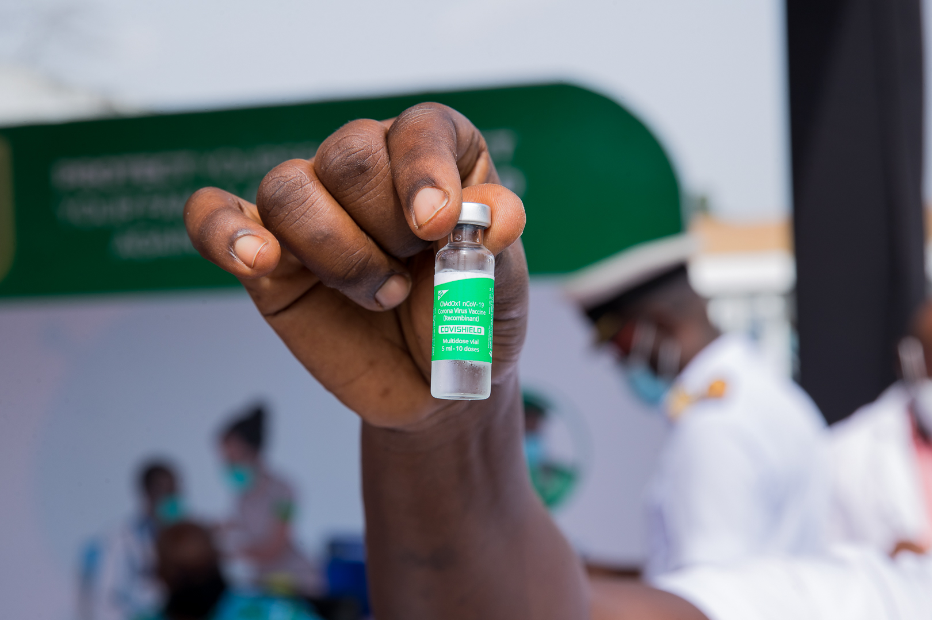
Background
Vaccine equity has been a really big issue in the past year
Africa has been left behind big-time, only 20.3% of African adults have received a first dose so far
Africa has received only 6% of the world’s vaccines, but it has 17% of the world’s population !!

Slide 3
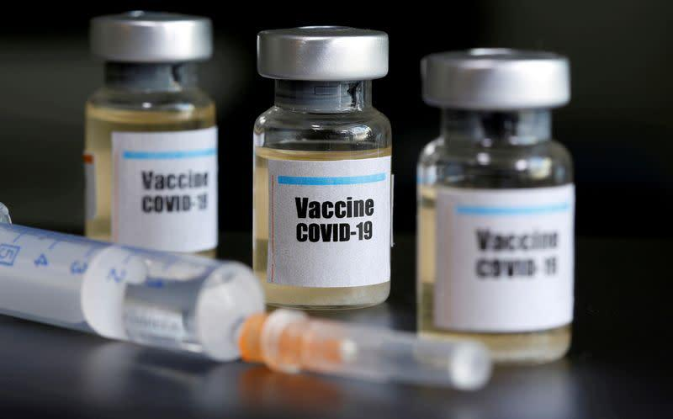
Background
Many reasons for the low vaccination rates:
Africa is poorer than the rest of the world so it was last priority for vaccine companies
Healthcare infrastructure is less developed in Africa so harder to distributie vaccines
More corruption on average so generally less effective responses to crises
Also, there is very little interest on the Internet (or in the scientific literature) about how well Africa’s vaccination program is projected to go

Slide 4
Data!
GDP
Healthcare infrastructure (got an index from the WHO)
Corruption (got an index from Transparency International)
Current and historical COVID vaccination rates
Historical vaccination rates for other diseases:
Tuberculosis
Yellow Fever
HPV

Slide 5
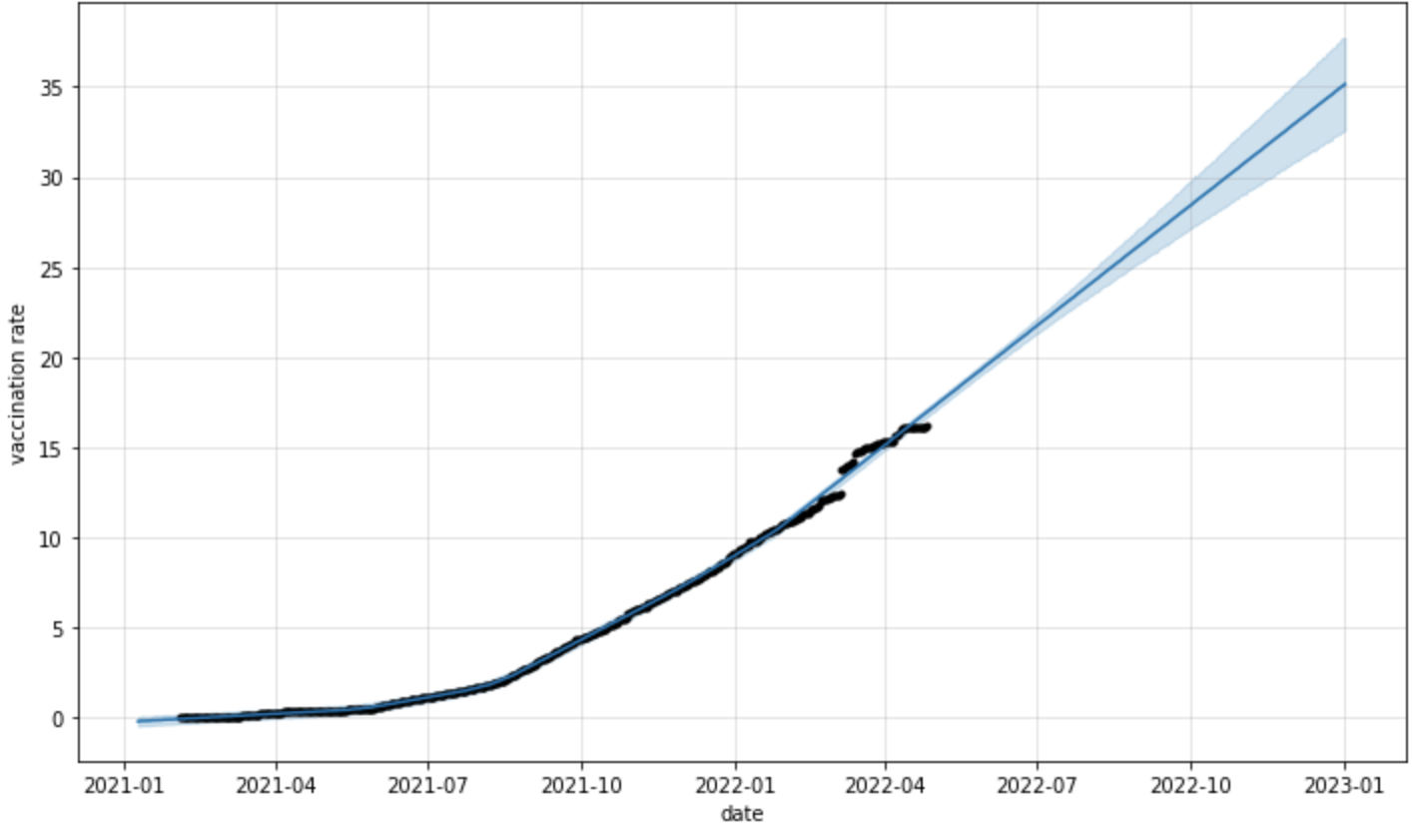
Method 0: Naive forecast, Time Series Model
Time series forecast using Facebook’s Prophet software
Accounts for seasonality, changes in trends and trend anomaly
Purportedly industrial grade
Mean: 35.41%,
CI: [32.71%, 37.96%]

Slide 6
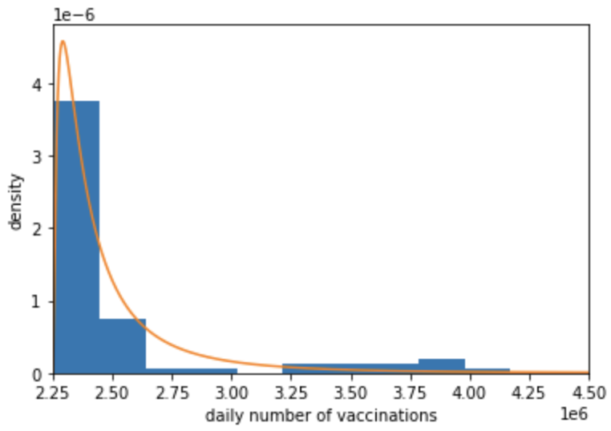
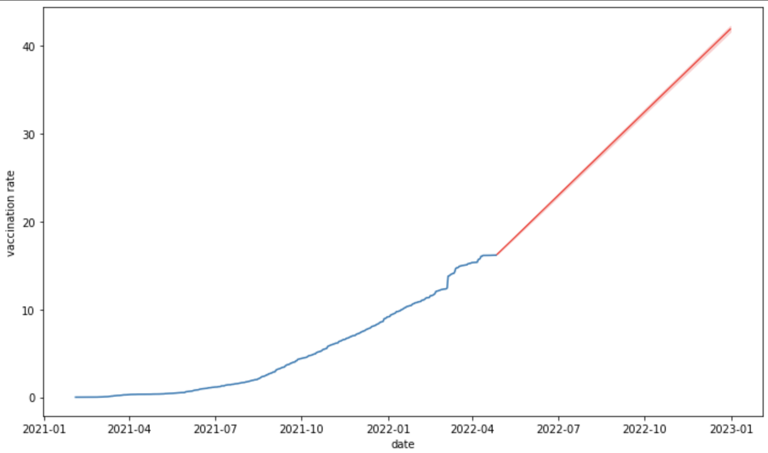
Method 1: curve fitting
Pooled daily # of vaccinations in 2022
Fitted log-normal distribution over the data
Sampled once for every remaining day of 2022 to generate a simulated trend
Repeated this 1,000 times and took the mean and 80% CI for each day
For vaccination rate at the end of 2022, ended up
with mean 41.92%, CI = [41.61%, 42.29%]

Slide 7
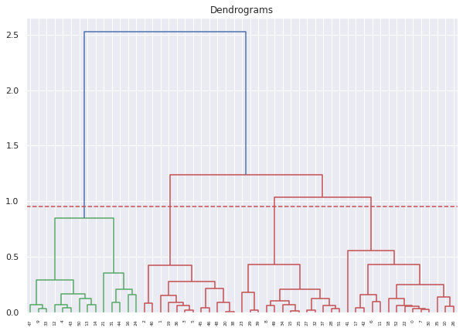
Method 2: Trend Extrapolation via Clusters
Three Variables Used to Cluster
GDP (Gross Domestic Product)
GHS (Global Healthcare Services Index)
CPI (Corruptions Perceptions Index)
Clustering Method
Hierarchical
Normalized each variable
Chose 4 based on clear gap as well as keeping first initial split together

Slide 8
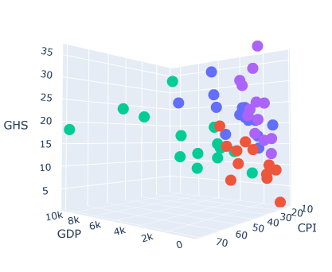
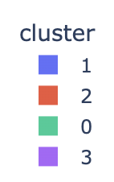
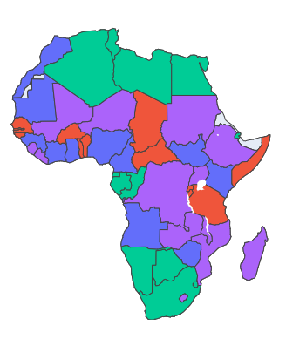
The Clusters!
Cluster | Color | # | GDP | CPI | GHS | Examples
0 | Green | 14 | High | High | Avg | South Africa, Algeria
1 | Blue | 14 | Avg | Avg | High | Kenya, Nigeria
2 | Red | 12 | Low | Avg | Low | Somalia, Chad
3 | Purple | 13 | Low | Avg | Avg | Ethiopia, Madagascar

Slide 9
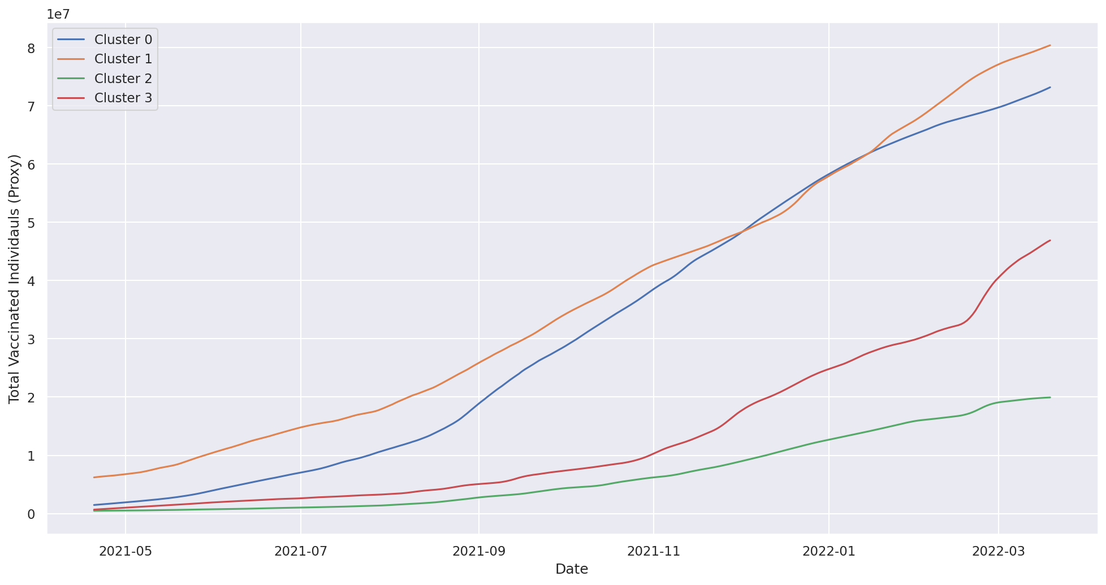
Number of Vaccinated People, per Cluster

Slide 10
Predictions
Cluster | GDP | CPI | GHS | Examples | Curr Vacc % | Elbow | Slope (per day) | Mean Pred. (End 2022) | 80% CI
0 | High | High | Avg | South Africa, Algeria | 29.32% | 2021-08-15 | 276k | 61.14% | [55%, 75%]
1 | Avg | Avg | High | Kenya, Nigeria | 16.71% | 2021-12-15 | 308k | 35.1% | [30%, 45%]
2 | Low | Avg | Low | Somalia, Chad | 10.24% | 2022-11-01 | 100k | 24.91% | [15%, 32%]
3 | Low | Avg | Avg | Ethiopia, Madagascar | 9.86% | 2022-02-15 | 456k | 37.34% | [20%, 50%]
Took slope at each elbow till the most recent day (March 19th, 2022)
Combined in Ratio to the cluster’s population:
Mean: 39.08%
80% CI: [28.97%, 50.24%]

Slide 11
Method 3: Reference Classes
Used data for TB, yellow fever and HPV vaccines to get estimates for percentage increase in vaccination per year
From TB, got a mean of +0.68%, CI = [0%, 6.42%]
From yellow fever, got a mean of 1.07%, CI = [0%, 9.63%]
From HPV, got a mean of -2.78%, so dropped this one lol
Assigning equal weight to TB and yellow fever, end up with mean projected vaccination rate 21.20%, CI = [20.3%, 28.33%]

Slide 12
Method 4: Combining Forecasts
Forecast Method | Mean | 80% CI | Weight
Prophet | 35.41% | [32.71, 37.96] | 35%
Curve Fitting | 41.92% | [41.62, 42.29] | 15%
Trend Extrapolation | 39.08% | [28.97, 50.24] | 47%
Reference Classes | 21.20% | [20.3, 28.33] | 3%
Combined Forecast | 37.69% | [31.92, 44.09] | 100%

Slide 13
Limitations
Missing Data
UN/WHO/UNICEF
Assumptions of Consistency with Vaccine Supply
Rollout Trends
Vaccine Availability
“Vaccine Ceiling”
At some point those who are left unvaccinated won’t want to take the vaccine -> vaccine rate will slow down

Slide 14
That’s all, folks!

